Slide 1
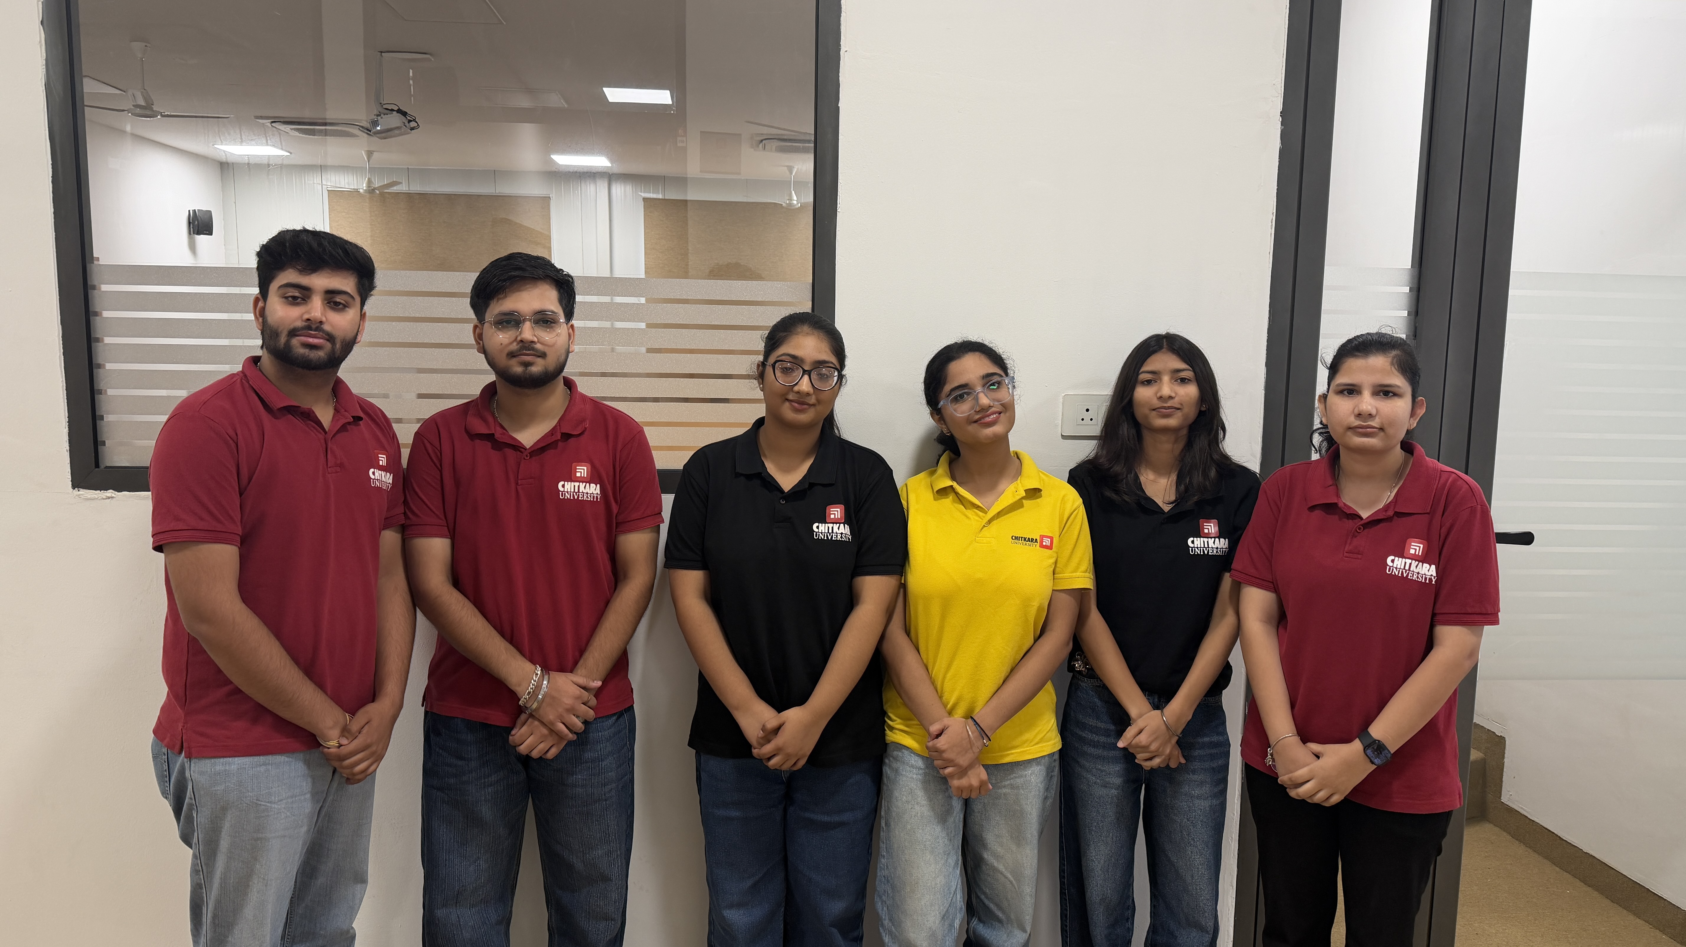
Anshika Kapoor
BUSINESS AI/ML CASE STUDY • PROMPT PORTFOLIO
PROJECT AUTHOR DETAILS
AI for Credit Risk Assessment
COURSE
AI & ML
PROJECT TEAM MEMBERS (6)
A Case Study on Loan Default Prediction in India's NBFC Lending Sector
MEMBER 1
Anshika Kapoor
Roll No: 2520992536
MEMBER 2
Aditya Thakur
Roll No: 2520992515
MEMBER 3
Ashpreet Kaur
Roll No: 2520992555
MEMBER 4
Khushmeet Kaur
Roll No: 2520992658
TEAM GROUP PHOTO
Placeholder — replace this box with your group photo
MEMBER 5
Jashanpreet Kaur
Roll No: 2520992633
MEMBER 6
Gaurav Chawla
Roll No: 2520992594
AI for Credit Risk Assessment in NBFC Lending
1

Slide 2
Industry Overview Anshika Kapoor
India's NBFC Lending Sector
What they do
Non-Banking Financial Companies (NBFCs) provide credit — personal, MSME, vehicle, gold and consumer-durable loans — often reaching borrowers traditional banks overlook.
SECTOR AT A GLANCE
₹48 trillion+
NBFC sector assets under management
Who they serve
Retail borrowers, small businesses and self-employed individuals, including many first-time and thin-credit-file customers.
~30%
Share of new digital lending disbursements
What they offer
Personal & consumer loans, MSME/business finance, gold loans, and fast digital-first lending products.
10.9 crore (₹1,06,548 crore)
Personal loans sanctioned by fintech-led NBFCs in FY 2024–25
Source: RBI Financial Stability Report (2025); AppWrk Insights, AI in NBFC Lending (2026)
AI for Credit Risk Assessment in NBFC Lending
2

Slide 3
The Business Problem Aditya Thakur
Predicting Loan Default Before It Happens
Loan default prediction estimates, before disbursement, the probability that a borrower will fail to repay — so the lender can approve, reject, or price the loan appropriately.
!
!
!
Explosive small-ticket growth
Bureau-only scoring falls short
Manual review is slow
Loans below ₹1 lakh have grown roughly 48x since 2017, mostly through NBFCs and fintechs.
Traditional CIBIL-only checks miss thin-file and first-time borrowers who lack credit history.
Conventional underwriting takes 3–5 days per application — too slow for instant-approval expectations.
AI for Credit Risk Assessment in NBFC Lending
3

Slide 4
Why This Problem Matters Aditya Thakur
The cost of getting underwriting wrong — in either direction
RISK OF MISSED DEFAULTS
RISK OF SLOW, MANUAL REVIEW
Rising non-performing assets (NPAs) increase provisioning costs and directly erode profitability.
Analysts have flagged asset-quality concerns in unsecured retail lending as growth accelerates.
Weak underwriting limits an NBFC's ability to raise funding at competitive rates.
3–5 day manual approval cycles lose price-sensitive borrowers to faster digital-first competitors.
Manual review cannot scale to India's growing volume of small-ticket digital loans.
Inconsistent human judgment can introduce unintentional bias into decisions.
AI for Credit Risk Assessment in NBFC Lending
4

Slide 5
Data Used to Solve It Aditya Thakur
1
2
3
Demographic (age)
Credit score
Loan details
Age, harmonized across sources (numeric, or midpoint of banded ranges).
Loan grade or numeric score, rescaled to a common 0–100 scale.
Loan amount requested and the interest rate offered.
4
5
6
Income & affordability
Employment
Outcome label
Annual income, debt-to-income %, and loan-to-income ratio.
Years employed, with a missing-value flag where unreported.
Target flag: 1 = defaulted, 0 = repaid — used to train and test models.
AI for Credit Risk Assessment in NBFC Lending
5

Slide 6
The AI/ML Approach Gaurav Chawla
Binary Classification — Comparing Three Models
WHY IT FITS THIS PROBLEM
WHAT THE MODEL DOES
✓
Logistic Regression's interpretable coefficients let a lender explain a flagged application — important for RBI transparency expectations.
Logistic Regression, Decision Tree, and Random Forest are trained on the same applicant features. Each outputs a probability between 0 and 1 — the estimated chance of default — which becomes a risk score.
✓
Decision Tree and Random Forest capture non-linear patterns a linear model alone would miss.
Classification • Supervised Learning • Model Comparison
✓
All three are scored on the same 70/30 split with Accuracy, Precision, Recall, F1 and ROC-AUC.
✓
Random Forest feature importance also drives feature selection earlier in the pipeline.
AI for Credit Risk Assessment in NBFC Lending
6

Slide 7
How It Works, Step by Step Gaurav Chawla
From applicant data to a business outcome
Applicant
Data
AI/ML
Model
Default
Probability
Underwriting
Decision
Business
Outcome
→
→
→
→
Filtered, cleaned, and feature-engineered real applicant data
3 models trained & compared on a 70/30 split
A 0–1 risk score per applicant
Approve, reject, or price the loan
Fewer bad loans, faster approvals
Pipeline: Filter → Clean & Engineer Features → Train & Compare 3 Models → Predict — mirroring Business Data → AI/ML System → Prediction → Business Outcome.
AI for Credit Risk Assessment in NBFC Lending
7

Slide 8
Expected Business Impact Jashanpreet Kaur
What the industry is already seeing from AI-based credit scoring
15–25%
Up to 30%
Minutes
~350 million
improvement in default-prediction accuracy from AI credit-scoring models
reduction in defaults reported where AI scoring has been adopted
typical underwriting time with AI, versus 3–5 days manually
first-time borrowers lenders could responsibly reach using AI-based assessment
Sources: Indiafintech, The Indian Bank's Guide to AI (2026); AppWrk Insights (2026); ResearchGate, Malhotra et al. (2025)
AI for Credit Risk Assessment in NBFC Lending
11

Slide 9
Risks, Ethics & Responsible AI Jashanpreet Kaur
What must be managed before deployment
▲
Data privacy & consent
▲
Bias & fairness
Banking/UPI data must be used strictly under the Account Aggregator consent framework.
Source dataset is deliberately excluded from modeling, so the model learns genuine risk patterns rather than which dataset a row came from.
▲
Transparency
Ongoing monitoring
▲
Models must be retested and retrained as borrower behaviour and the market shift over time.
RBI's 2023 Responsible AI discussion paper expects lenders to be able to explain automated credit decisions.
▲
Human oversight
Borderline and high-value applications should always get human review, not a fully automatic decision.
AI for Credit Risk Assessment in NBFC Lending
12

Slide 10
AI Tools Used in This Research Ashpreet Kaur
Generative AI as a research and analysis assistant
Tool | Used For
ChatGPT | Understanding AI/ML concepts and structuring the case study
Claude | Building and explaining the Python logistic-regression model; analysing long research material
Perplexity | Finding and cross-checking sources and industry statistics
EXAMPLE PROMPT USED
“Explain how Indian NBFCs use AI/ML for loan default prediction. Focus on the data sources used, the type of model, and evidence of real-world adoption. Provide reliable sources.”
AI for Credit Risk Assessment in NBFC Lending
13

Slide 11
Refining the Prompt — and the Output Ashpreet Kaur
Prompt improvement and critical evaluation of AI output
BASIC PROMPT
IMPROVED PROMPT
“Tell me about AI in loan default prediction.”
“Act as a credit risk analyst. Explain how Indian NBFCs use AI/ML for loan default prediction, including data sources, model types, real adoption figures, and RBI's Responsible AI expectations. Cite reliable sources.”
WHY IT WORKED BETTER
Assigning a role, naming the industry (Indian NBFCs), and asking for figures + sources turned a generic overview into a specific, checkable, India-focused answer.
AI OUTPUT CORRECTED DURING RESEARCH
An early AI answer cited generic global adoption figures instead of India-specific ones, with no source. It was verified against the RBI Financial Stability Report and industry publications, then replaced with the sourced, India-specific statistics used in this deck.
AI for Credit Risk Assessment in NBFC Lending
14

Slide 12
Recommendations & Key Takeaways khushmeet Kaur
RECOMMENDATION
NBFCs should validate scoring models on real transaction data, compare multiple model types on the same evaluation split, keep the chosen model interpretable enough for RBI explainability needs, and mandate human review for borderline or high-value cases.
REFERENCES
Indiafintech, The Indian Bank's Guide to AI (2026)
AppWrk Insights, AI in NBFC Lending (2026)
Biz2X, AI Credit Decisioning for Banks & NBFCs (2025)
Malhotra et al., ResearchGate (2025)
Kaggle: Credit Risk Dataset; Loan Default Dataset
LEARNING REFLECTION
Training and comparing three real models (Logistic Regression, Decision Tree, Random Forest) showed how model choice trades off interpretability against accuracy.
Learned that prompt specificity (role, scope, request for sources) sharply changes research quality.
Learned to verify AI-generated statistics against primary sources like RBI reports before using them.
AI for Credit Risk Assessment in NBFC Lending
15

Slide 13

Project Contributors & GitHub IDs Khushmeet Kaur
GitHub handles for team members and project collaborators
code
Anshika Kapoor
https://github.com/anshikakapoor707-coder
code
Khushmeet Kaur
https://github.com/khushmeet07
code
Ashpreet Kaur
https://github.com/Ashpreet06
code
Jashanpreet Kaur
https://github.com/jashanpreetk2308-create
code
Aditya Thakur
https://github.com/Aditya2307-CODER
code
Gaurav Chawla
https://github.com/gaurav2594bbafai25-ui
AI for Credit Risk Assessment in NBFC Lending
16

